Slide 1


Welcome to the Spektrix Patterns Group
Visitor Pattern

Slide 2
Agenda
To discuss and improve our understanding of design patterns. Initially we'll follow the 23 week guide covering the Gang of Four Design Patterns laid out by Joshua Kerievsky here - https://www.industriallogic.com/papers/learning.html
Although we'll introduce the Pattern with a code example at the start of the meeting, this is not designed to be a training session, it's intended to be a Study group to consider various questions about the pattern. In doing so we'll benefit from the wisdom of the crowd and hopefully improve our understanding.
Deep knowledge of patterns isn't required, and a diverse range of perspectives is encouraged, but it would be useful preparation if you have studied the pattern that'll be discussed before each session.
1 hour approximately
Description of sample code that needs refactoring
Introduction to Visitor Pattern and brief demonstration - 10 minutes
Split into groups for practice - 20 minutes
Retro - 20 mins

Slide 3
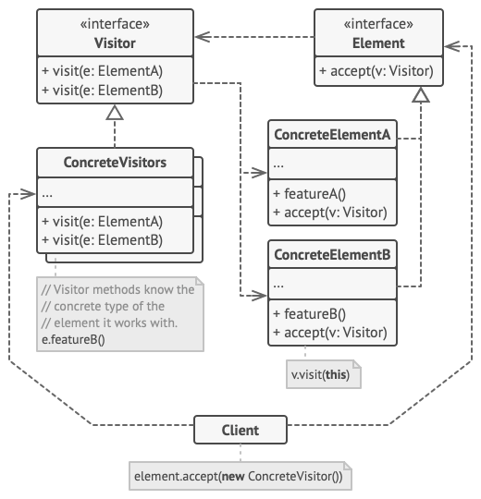
Visitor Pattern
The “Visitor” Design pattern is a way of separating an algorithm from an object structure on which it operates. A practical result of this separation is the ability to add new operations to existing object structures without modifying the structures.
Notes:
Concept Introduce the visitor pattern and explain its applicability The Visitor pattern can be used when you are working with complex object structure (for example, an object tree) of abstract types. As you iterate the list, you find that you are having to identify the concrete type of the object and apply different logic based on that type
You can use the Visitor to delegate the business logic that needs to apply to these types onto the type itself, or its domain.
The pattern lets you make the logic implementation of your app more focused on their main jobs by extracting all other behaviours into a set of visitor classes.
Use the pattern when a behaviour makes sense only in some classes of a class hierarchy, but not in others.
You can extract this behaviour into a separate visitor class and implement only those visiting methods that accept objects of relevant classes, leaving the rest empty.
Demonstrate the Check in Desk Visitor

Slide 4
Airport Example
Passengers arriving at an airport are directed to a queue for a check in desk. They are then directed to a departure lounge. Boarding the aeroplane is done in order of the allocated seat class.
Once aboard, an Airline flight attendant serves complimentary drinks, depending on the seating class.
Notes:
Demonstrate the Airport Add Passenger method - Show how the switch statement interrogates the concrete type from the abstract Interface - Demonstrate how the IPassenger abstract prevents type overloading the Go To Desk method even for languages which support it
Show how the switch statement is present in the AddPassenger methods of Departure lounge, Boarding Gate, and the iteration In Flight Service Implement an IAirportVisitor interface with a void Visit method for each concrete type of IPassenger public interface IAirportVisitor
{
void VisitPassenger(EconomyPassenger passenger);
void VisitPassenger(PremiumEconomyPassenger passenger);
void VisitPassenger(BusinessPassenger passenger);
void VisitPassenger(FirstClassPassenger passenger);
}
Add an Accept method onto IPassenger void Accept(IAirportVisitor visitor);
Implement this in each derived type: public void Accept(IAirportVisitor visitor) => visitor.VisitPassenger(this);
Add the IAirportVisitor interface to Airport
and implement the missing members directing the passengers to the appropriate GoTo[]Desk method Replace the switch in AddPassenger with passenger.Accept(this); Demonstrate that the tests still pass Split into Implementation groups and practice implementing the pattern on the other algorithms

Slide 5
Questions
SOLID Principles:
Single responsibility principle
A class should have only a single responsibility, that is, only changes to one part of the software's specification should be able to affect the specification of the class.
Open–closed principle
"Software entities ... should be open for extension, but closed for modification."
Liskov substitution principle
"Objects in a program should be replaceable with instances of their subtypes without altering the correctness of that program." See also design by contract.
Interface segregation principle
"Many client-specific interfaces are better than one general-purpose interface."
Dependency inversion principle
One should "depend upon abstractions, [not] concretions."
How does Visitor pattern allow us to add different behavior for generic types?
What other patterns can we use instead?
Does the baggage weight algorithm cause an issue?
Notes:
Visual reminder show the UML Ask about Solid principles
How clean is this pattern? What other patterns are alternatives Maybe a Mentimeter poll for which patterns are more or less complex Does the baggage weight algorithm cause an issue with encapsulation?

